Slide 1
Grasslands Considered:
Regulatory Consideration and Protection of Alberta’s Native Grasslands
Presented by
Brenda Heelan Powell, ELC Staff Counsel
March 13, 2025

Slide 2
About the Environmental Law Centre
The Environmental Law Centre (ELC) is a registered charity and has been seeking strong and effective environmental laws since it was founded in 1982.
The ELC is dedicated to providing credible, comprehensive and objective legal information regarding natural resources, energy and environmental law, policy and regulation in the Province of Alberta.
elc@elc.ab.ca elc.ab.ca​

Slide 3
Today’s Webinar
Alberta’s Native Grasslands
What does the law do to protect native grasslands?
How do native grasslands factor into regulatory decision-making?
Land Management Decisions - Public lands
Land Management Decisions – Private lands
Alberta Utilities Commission
Alberta Energy Regulator
Natural Resources Conservation Board
Canada Energy Regulator
elc@elc.ab.ca elc.ab.ca​

Slide 4
Native Grasslands Defined
Native grassland
A landscape unit where the vegetation is dominated by grasses, grass like plants, and/or forbs (>50 per cent)… For grasslands to be defined as “native”, they must be comprised of greater than 30 per cent foliar cover of native grassland species.
GOA, Conservation Assessments in Native Grasslands (2018)
GOA, Natural Regions and Subregions of Alberta: A Framework for Alberta’s Parks (2014)
elc@elc.ab.ca elc.ab.ca​

Slide 5
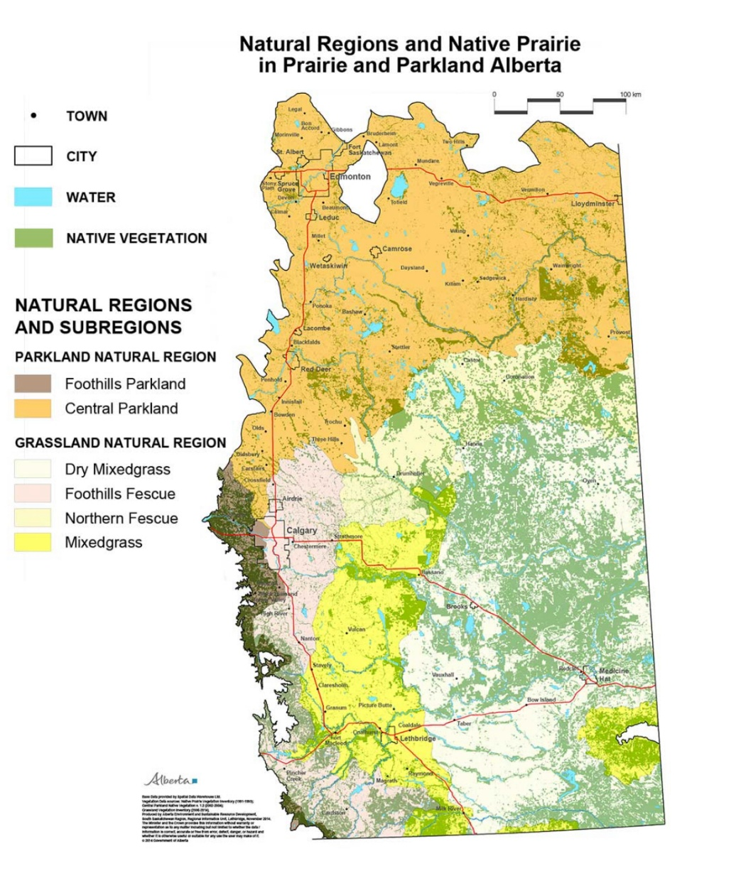
Alberta’s Native Grasslands
elc@elc.ab.ca elc.ab.ca​

Slide 6
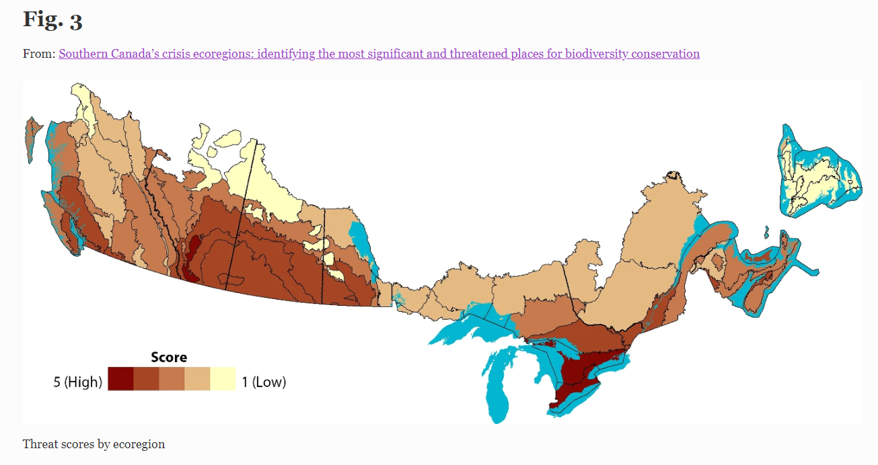
Loss of Native Grasslands
Daniel Kraus and Andrea Hebb, “Southern Canada’s crisis ecoregions: identifying the most significant and threatened places for biodiversity conservation, Biodiversity and Conservation, 29, 3573-3590 (2020), online: https://link.springer.com/article/10.1007/s10531-020-02038-x
elc@elc.ab.ca elc.ab.ca​

Slide 7
Drivers of Native Grassland Loss
Loss due to conversion
Fragmentation from linear disturbances
Impairment from invasive species
elc@elc.ab.ca elc.ab.ca​

Slide 8
Why do we care about grasslands conservation and protection?
Daniel Kraus and Andrea Hebb, “Southern Canada’s crisis ecoregions: identifying the most significant and threatened places for biodiversity conservation, Biodiversity and Conservation, 29, 3573-3590 (2020),
online: https://link.springer.com/article/10.1007/s10531-020-02038-x
elc@elc.ab.ca elc.ab.ca​

Slide 9
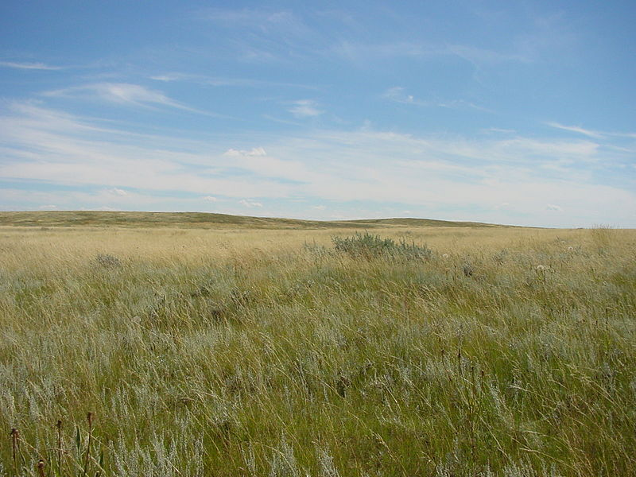
What does the law do to protect native grasslands?
Photo: Brett Snyder
elc@elc.ab.ca elc.ab.ca​

Slide 10
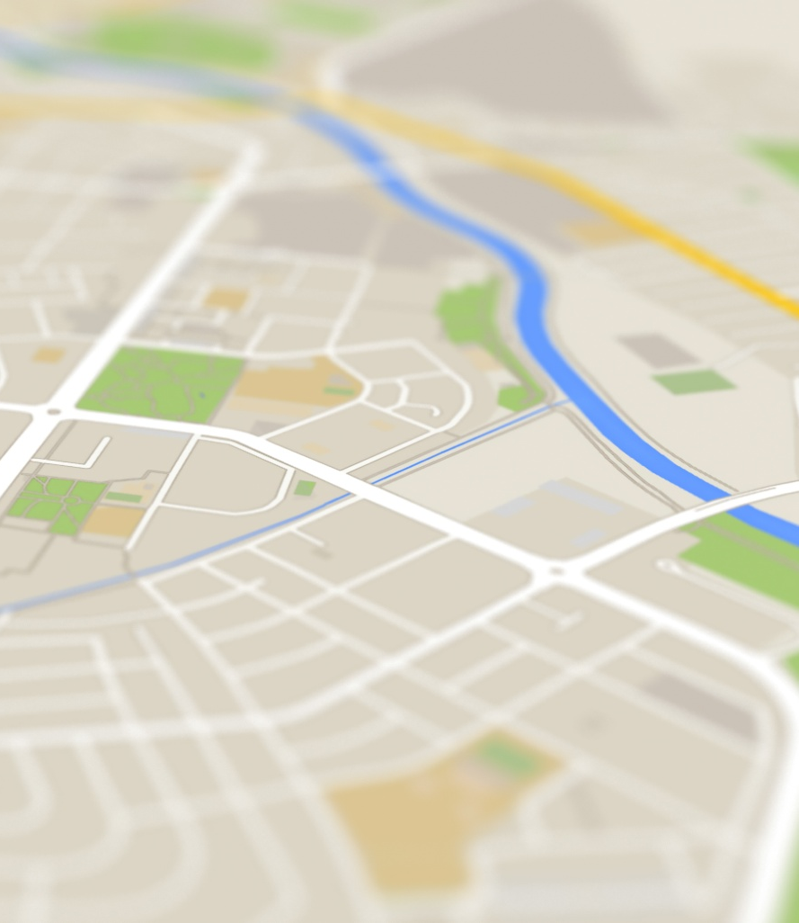
Protected Areas, Land Use Planning & Land Management Legislation
Wilderness Areas, Ecological Reserves, Natural Areas and Heritage Rangelands Act
Black Creek Heritage Rangeland and OH Ranch Heritage Rangeland
Alberta Land Stewardship Act
Regional planning (South Saskatchewan Regional Plan)
Public Lands Act
Dispositions to enter or use public lands (AER and Forestry & Parks)
Municipal Government Act
Planning and development (private lands)
elc@elc.ab.ca elc.ab.ca​

Slide 11
Resource Activities Regulation Legislation
Each resource activity has its own regulatory scheme and legislation
AUC: power facilities including renewables
AER: oil and gas, coal, oil sands, geothermal activities, brine-hosted minerals, and rock-based minerals
NRCB: ILOs and large recreational facilities
CER: federally regulated pipelines
General environmental legislation applies
Environmental Protection and Enhancement Act
remediation standard, release of substances (pollution)
Water Act
use and diversion of water, land-based activities that impact water
elc@elc.ab.ca elc.ab.ca​

Slide 12
Grassland Policies
Oil and Gas Operations
2010 Reclamation Criteria for Wellsites and Associated Facilities for Native Grasslands
AER Manual 007: Principles for Minimizing Surface Disturbance in Native Prairie and Parkland Areas
Renewable Energy Operations
Wildlife Directives for Alberta Wind Energy Projects
Wildlife Directives for Alberta Solar Energy Projects
Grazing Operations
Grazing Lease Stewardship Code of Practice
Operating Standards for Alberta’s Public Grazing Dispositions
Range Inventory Manual
Industrial Activities
Numerous policies addressing: recovery strategies, conservation assessments, principles to minimize surface disturbances
avoid native grassland,
minimize impacts and
mitigate negative impacts
elc@elc.ab.ca elc.ab.ca​

Slide 13
How does native grasslands protection factor into regulatory decision-making?
elc@elc.ab.ca elc.ab.ca​

Slide 14
ELC’s Regulatory Evaluation Framework
elc@elc.ab.ca elc.ab.ca​

Slide 15
Land Management Decision-Making: Public Lands
Public Lands Act (AER, Forestry and Parks)
Decisions around designating protected areas (eg Heritage Rangelands) and Public Land Use Zones
Crown Land Reservations (CLRs), purposes can include land management, land use plans, parks/protected areas, unique site features
dispositions to enter or use public lands (Forestry & Parks) subject to Master Schedule of Standards and Conditions which include grassland-specific standards and conditions (reflect avoid, minimize and mitigate)
More information on CLRs and MSSC in the Pre-Application for formal dispositions document
elc@elc.ab.ca elc.ab.ca​

Slide 16
Land Management Decision-Making: Private Lands
Municipal Government Act and Surface Rights Act (Land and Property Rights Tribunal)
MGA grants authority to municipalities to made land use planning and development decisions
SRA establishes process to allow oil and gas operators access to private lands when cannot negotiate agreement with surface landowner (right of entry orders)
Looked at decisions of LPRT
elc@elc.ab.ca elc.ab.ca​

Slide 17
Alberta Utilities Commission
authority for power plant projects
Relevant Policies and Guidelines
Wildlife Directives for Alberta Wind Energy Projects
Wildlife Directives for Alberta Solar Energy Projects
General Industrial Activities: numerous policies addressing: recovery strategies, conservation assessments, principles to minimize surface disturbances
elc@elc.ab.ca elc.ab.ca​

Slide 18
Alberta Energy Regulator
authority for decision-making for oil and gas, coal, geothermal, brine-hosted minerals, rock-hosted minerals
Relevant Policies and Guidelines
2010 Reclamation Criteria for Wellsites and Associated Facilties for Native Grasslands
AER Manual 007: Principles for Minimizing Surface Disturbance in Native Prairie and Parkland Area
General Industrial Activities: numerous policies addressing: recovery strategies, conservation assessments, principles to minimize surface disturbances
MSSC
elc@elc.ab.ca elc.ab.ca​

Slide 19
Alberta Energy Regulator
elc@elc.ab.ca elc.ab.ca​

Slide 20
Natural Resource Conservation Board
decisions around major natural resource projects (i.e. forestry, water management, recreation) and confined feeding operations (CFOs)
NRCB panel makes decisions around natural resource projects on public interest grounds
Approval officers make decisions around CFO approvals (which may be appealed and assessed by NRCB panel)
elc@elc.ab.ca elc.ab.ca​

Slide 21
Canada Energy Regulator
authority around inter-provincial pipelines or electrical power-line projects
joint assessments may occur if the project is designated under the Impact Assessment Act
elc@elc.ab.ca elc.ab.ca​

Slide 22
Key Conclusions
There is a need for a comprehensive native grasslands policy which will provide greater direction to decision-makers.
Native grasslands are not consistently treated in decisions:
seems to be little inclination to deny projects due to the presence of native grasslands – how mush avoidance is needed?
conditions are often imposed (but sometimes commitments are deemed to be enough)
remove incentives to cultivate
elc@elc.ab.ca elc.ab.ca​

Slide 23
Next Steps
What are the contents of a comprehensive native grassland policy?
Are statutory authorization and disposition conditions and/or commitments being met?
Do those conditions achieve conservation and protection of native grasslands?
elc@elc.ab.ca elc.ab.ca​

Slide 24
Questions?
As a charity, the Environmental Law Centre depends on your financial support.
Your support makes a difference!
Donate online today at www.elc.ab.ca or contact elc@elc.ab.ca about corporate sponsorships
Charitable registration 11890 0679 RR0001
elc@elc.ab.ca elc.ab.ca​

Slide 25
Contact the ELC
Telephone: (780) 424-5099
Email: bhpowell@elc.ab.ca
Website: www.elc.ab.ca
Blog: http://elc.ab.ca/blog/
Facebook: http://www.facebook.com/environmentallawcentre
Twitter: https://twitter.com/ELC_Alberta
To sign up for the ELC e-newsletter visit:
https://elc.ab.ca/contact-us/

